Slide 1
Sparse matrix formats

Slide 2
Outline
In this topic, we will cover:
Sparse matrices
A row-column-value representation
The old Yale sparse matrix data structure
Examples
Appropriate use

Slide 3
Dense versus sparse matrices
A dense N × M matrix is one where most elements are non-zero
A dense matrix data structure is one that has a memory location allocated for each possible matrix entry
These require Θ(NM) memory
A sparse matrix is where 90 % or more of the entries are zero
If m is the number of non-zero entries,
The density is m/MN
The row density is m/N
Operations and storage should depend on m
For sparse matrices, m = o(MN)

Slide 4
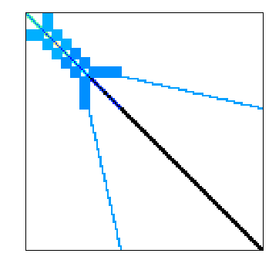
Example
A dense 1 585 478 square matrix of doubles would occupy 18 TiB
The matrix representation of the AMD G3 processor has only 7 660 826 non-zero entries
The density is 0.000003
The matrix is used for circuit simulation
Simulations requires solving a system of 1,585,478 equations in that many unknowns
http://www.cise.ufl.edu/research/sparse/matrices/AMD/G3_circuit.html

Slide 5
Dense square matrix data structure
This class stores N × N matrices with 8 + 4N + 8N² = Θ(N²) bytes
class Matrix {
private:
int N;
double **matrix;
public:
Matrix( int n );
// ...
};
Matrix::Matrix( int n ):
N( std::max(1, n) ),
matrix( new double *[N] ) {
matrix[0] = new double[N*N];
for ( int i = 1; i < N; ++i ) {
matrix[i] = matrix[0] + i*N;
}
}
pointer arithmetic

Slide 6
Row-Column-Value Representation
As an example:
matrix
1.5 | 0 | 0 | 0 | 0 | 0 | 0 | 0 | 0 | 2.3 | 0 | 1.4 | 0 | 0 | 0 | 0 | 0 | 0 | 3.7 | 0 | 0 | -2.7 | 0 | 0 | 0 | -1.6 | 0 | 2.3 | 0 | 0 | 0 | 0

Slide 7
Row-Column-Value Representation
Suppose we store triplets for each non-zero value:
We would have (0, 0, 1.5), (1, 1, 2.3), (1, 3, 1.4), (2, 2, 3.7), …
The class would be
class Triplet {
int row;
int column;
double value;
};

Slide 8
Row-Column-Value Representation
Now the memory requirements are Θ(m)
class Sparse_matrix {
private:
int matrix_size;
int N;
int array_capacity;
Triplet *entries;
public:
Sparse_matrix( int n, int c = 128 );
};
Sparse_matrix( int n, int c ):
matrix_size( 0 ),
N( std::max(1, n) ),
array_capacity( std::max(1, c) ),
entries( new Triplet[array_capacity] ) {
// does nothing
}

Slide 9
Row-Column-Value Representation
For the same example, we have:
entries
0 | 1 | 1 | 2 | 2 | 3 | 3 | 4 | 5 | 6 | 6 | 7
0 | 1 | 3 | 2 | 5 | 1 | 3 | 4 | 5 | 2 | 6 | 7
1.5 | 2.3 | 1.4 | 3.7 | –2.7 | –1.6 | 2.3 | 5.8 | 7.4 | 1.9 | 4.9 | 3.6

Slide 10
Row-Column-Value Representation
We fill in the entries in row-major order
entries
0 | 1 | 1 | 2 | 2 | 3 | 3 | 4 | 5 | 6 | 6 | 7
0 | 1 | 3 | 2 | 5 | 1 | 3 | 4 | 5 | 2 | 6 | 7
1.5 | 2.3 | 1.4 | 3.7 | –2.7 | –1.6 | 2.3 | 5.8 | 7.4 | 1.9 | 4.9 | 3.6

Slide 11
Row-Column-Value Representation
The AMD G3 circuit now requires 117 MiB versus 18 TiB
http://www.cise.ufl.edu/research/sparse/matrices/AMD/G3_circuit.html

Slide 12
Accessing Entries
Adding and erasing entries (setting to 0) requires a lot of work
They are require O(m) copies
entries
0 | 1 | 1 | 2 | 2 | 3 | 3 | 4 | 5 | 6 | 6 | 7
0 | 1 | 3 | 2 | 5 | 1 | 3 | 4 | 5 | 2 | 6 | 7
1.5 | 2.3 | 1.4 | 3.7 | –2.7 | –1.6 | 2.3 | 5.8 | 7.4 | 1.9 | 4.9 | 3.6

Slide 13
Accessing Entries
By using row-major order, the indices are lexicographically ordered
We may search using a binary search: O(ln(m))
entries
0 | 1 | 1 | 2 | 2 | 3 | 3 | 4 | 5 | 6 | 6 | 7
0 | 1 | 3 | 2 | 5 | 1 | 3 | 4 | 5 | 2 | 6 | 7
1.5 | 2.3 | 1.4 | 3.7 | –2.7 | –1.6 | 2.3 | 5.8 | 7.4 | 1.9 | 4.9 | 3.6

Slide 14
Old Yale Sparse Matrix Format
Storing the row, column, and value of each entry has some undesirable characteristics
Accessing an entry is O(ln(m))
For the AMD G3, lg(7,660,826) = 23
If each row has approximately the same number of entries, we can use an interpolation search: O(ln(ln(m)))
For the AMD G3, ln(ln(7,660,826)) = 3

Slide 15
Old Yale Sparse Matrix Format
The original (old) Yale sparse matrix format:
Reduces access time to lg(m/N) and uses less memory
For circuits, it is seldom that m/N > 10
For the AMD G3 circuits, m/N < 5
It was developed by Eisenstat et al. in the late 1970s

Slide 16
Old Yale Sparse Matrix Format
Note that the arrays have redundancy
Any row which contains more than one entry is stored in successive entries
entries
entries
0
1
2
3
4
5
6
7
8
9
10
11
0 | 1 | 1 | 2 | 3 | 3 | 3 | 4 | 5 | 6 | 6 | 7
0 | 1 | 3 | 2 | 5 | 1 | 3 | 4 | 5 | 2 | 6 | 7
1.5 | 2.3 | 1.4 | 3.7 | –1.6 | 2.3 | 9.9 | 5.8 | 7.4 | 1.9 | 4.9 | 3.6

Slide 17
Old Yale Sparse Matrix Format
Suppose we store only the location of the first entry of each row:
The first entry in Row 0 is in entry 0
The first entry in Row 3 is in entry 4
entries
0
1
2
3
4
5
6
7
8
9
10
11
0 | 1 | 1 | 2 | 3 | 3 | 3 | 4 | 5 | 6 | 6 | 7
0 | 1 | 3 | 2 | 5 | 1 | 3 | 4 | 5 | 2 | 6 | 7
1.5 | 2.3 | 1.4 | 3.7 | –1.6 | 2.3 | 9.9 | 5.8 | 7.4 | 1.9 | 4.9 | 3.6

Slide 18
Old Yale Sparse Matrix Format
Let us remove that redundancy by creating a new array IA where IA(i) stores the location in JA and A of the first non-zero entry in the i^{th} row
Rename the column and value arrays to JA and A, respectively
IA
0
1
2
3
4
5
6
7
8
0 | 1 | 3 | 4 | 7 | 8 | 9 | 11 | 12
JA
0
1
2
3
4
5
6
7
8
9
10
11
A
0 | 1 | 3 | 2 | 5 | 1 | 3 | 4 | 5 | 2 | 6 | 7
1.5 | 2.3 | 1.4 | 3.7 | –1.6 | 2.3 | 9.9 | 5.8 | 7.4 | 1.9 | 4.9 | 3.6

Slide 19
Old Yale Sparse Matrix Format
For example, the first entry of the 3rd row is located at position IA(3)
IA
0
1
2
3
4
5
6
7
8
0 | 1 | 3 | 4 | 7 | 8 | 9 | 11 | 12
JA
0
1
2
3
4
5
6
7
8
9
10
11
A
0 | 1 | 3 | 2 | 5 | 1 | 3 | 4 | 5 | 2 | 6 | 7
1.5 | 2.3 | 1.4 | 3.7 | –1.6 | 2.3 | 9.9 | 5.8 | 7.4 | 1.9 | 4.9 | 3.6

Slide 20
Old Yale Sparse Matrix Format
Also, the first entry of the 4th row is located at position IA(4)
The entries of Row 4 are in 4, 5, 6
IA
0
1
2
3
4
5
6
7
8
0 | 1 | 3 | 4 | 7 | 8 | 9 | 11 | 12
JA
0
1
2
3
4
5
6
7
8
9
10
11
A
0 | 1 | 3 | 2 | 5 | 1 | 3 | 4 | 5 | 2 | 6 | 7
1.5 | 2.3 | 1.4 | 3.7 | –1.6 | 2.3 | 9.9 | 5.8 | 7.4 | 1.9 | 4.9 | 3.6

Slide 21
Old Yale Sparse Matrix Format
Searching for entry a_{i,j} now only requires you to search
double a = 0.0; for ( int k = IA[i]; k < IA[i + 1]; ++k ) { if ( JA[k] == j ) {
a = A[k];
}
}
For larger row densities, use binary search
IA
0
1
2
3
4
5
6
7
8
0 | 1 | 3 | 4 | 7 | 8 | 9 | 11 | 12
JA
0
1
2
3
4
5
6
7
8
9
10
11
A
0 | 1 | 3 | 2 | 5 | 1 | 3 | 4 | 5 | 2 | 6 | 7
1.5 | 2.3 | 1.4 | 3.7 | –1.6 | 2.3 | 9.9 | 5.8 | 7.4 | 1.9 | 4.9 | 3.6

Slide 22
Old Yale Sparse Matrix Format
Our class could look something like requring 28 + 4N + 12m bytes:
class Old_yale_sparse_matrix {
private:
int matrix_size, N, array_capacity;
int *IA, *JA
double *A;
public:
Old_yale_sparse_matrix( int n, int c = 128 );
// other member functions
};
Old_yale_sparse_matrix::Old_yale_sparse_matrix( int n, int c ):
matrix_size( 0 ),
N( std::max(1, n) ),
array_capacity( std::max(1,c) ),
IA = new int[N + 1];
JA = new int[array_capacity];
A = new double[array_capacity] {
for ( int i = 0; i <= N; ++i ) {
IA[i] = 0;
}
}

Slide 23
Old Yale Format: The Zero Matrix
We initialize the matrix to the zero matrix
IA
0
1
2
3
4
5
6
7
8
0 | 0 | 0 | 0 | 0 | 0 | 0 | 0 | 0
JA
0
1
2
3
4
5
6
7
8
9
10
11
A

Slide 24
Old Yale Format: Access
To demonstrate accessing on the AMD G3 circuit, let us determine the weights of the connections to element 1001
Looking up the array IA[1001], we note that the results are stored starting at locations 2500, 2501, and 2502 in JA and A
IA
996 | 2488
997 | 2490
998 | 2493
999 | 2495
1000 | 2498
1001 | 2500
1002 | 2503
1003 | 2505
1004 | 2508
1005 | 2510
1006 | 2513

Slide 25
Old Yale Format: Access
JA
A
2491 | 998 | -0.548426E+00
2492 | 156375 | -0.200000E+01
2493 | 998 | 0.109685E+01
2494 | 999 | -0.548426E+00
2495 | 999 | 0.309685E+01
2496 | 1000 | -0.548426E+00
2597 | 156689 | -0.200000E+01
2598 | 1000 | 0.109685E+01
2599 | 1001 | -0.548426E+00
2500 | 1001 | 0.309685E+01
2501 | 1002 | -0.548426E+00
2502 | 157003 | -0.200000E+01
2503 | 1002 | 0.109685E+01
2504 | 1003 | -0.548426E+00
2505 | 1003 | 0.309685E+01
2506 | 1004 | -0.548426E+00
2507 | 157317 | -0.200000E+01
2508 | 1004 | 0.109685E+01
2509 | 1005 | -0.548426E+00
2510 | 1005 | 0.309685E+01
Viewing these two arrays, we have:
a_{1001,1001} = 3.09685
a_{1001,1002} = –0.54826
a_{1001,157003} = –2.0
996 | 2488
997 | 2490
998 | 2493
999 | 2495
1000 | 2498
1001 | 2500
1002 | 2503
1003 | 2505
1004 | 2508
1005 | 2510
1006 | 2513

Slide 26
Old Yale Format: Memory Use
Storing a sparse 8 × 8 matrix with 12 non-zero entries:
Full matrix: 8 + 4N + 8N² = 552 bytes
Row-column-value: 24 + 16m = 216 bytes
Old Yale format: 28 + 4N + 12m = 204 bytes
For the AMD G3 circuit where N = 1585478 and m = 7660826
Full matrix: 8 + 4N + 8N² = 19 178 324 MiB
Row-column-value: 24 + 16m = 117 MiB
Old Yale format: 28 + 4N + 12m = 94 MiB

Slide 27
Old Yale Sparse Matrix Format
This format is the basis for:
the Harwell-Boeing matrix format, and
the internal representation by Matlab
the new Yale sparse matrix format
The first two swap rows and columns...
Old Yale format is row major
Matlab and the Harwell-Boeing are column major

Slide 28
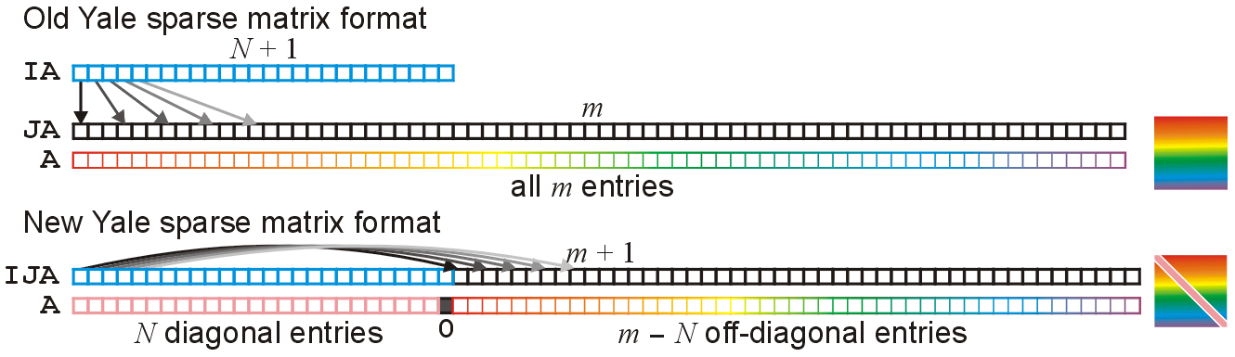
New Yale Sparse Matrix Format
The new Yale format makes use of:
diagonal entries are almost always non-zero
the diagonal entries are most-often accessed
Thus, store diagonal entries separately:

Slide 29
New Yale Sparse Matrix Format
The benefits are quite clear:
Memory usage is less: 28 + 12m bytes
Access to diagonal entries is now Θ(1)

Slide 30
New Yale Sparse Matrix Format
An implementation of the new Yale sparse matrix format is at
http://ece.uwaterloo.ca/~dwharder/aads/Algorithms/Sparse_systems/
This includes:
Constructors, etc.
Matrix and vector functions: norms, trace, etc.
Matrix-matrix and matrix-vector operations
Various solvers:
Jacobi, Gauss-Seidel, forward and backward substitution
Steepest descent, minimal residual, and residual norm steepest descent methods

Slide 31
Operations
Suppose that N × N matrices have m = Θ(N) non-zero entries
At most a fixed number of entries per row
Many Θ(N²) are reduced to Θ(N) run times, including:
Matrix addition—similar to merging
Matrix scalar multiplication
Matrix-vector multiplication
Forward and backward substitution
Even finding the M = PLU decomposition is now O(N²) and not Θ(N³)

Slide 32
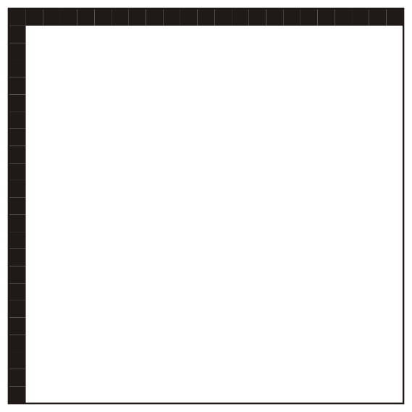
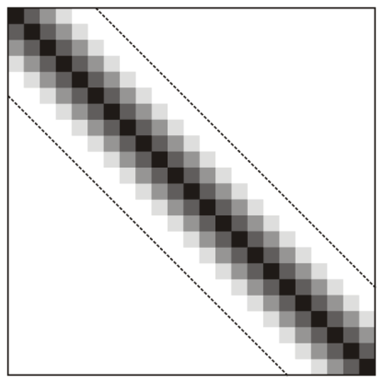
Operations
The M = PLU decomposition, however, may still be Θ(N³)
The worst case is where the first row and column are dense
A matrix which has most entries around the diagonal is said to be a band diagonal matrix
If all entries are Θ(1) of the diagonal, Gaussian elimination and PLU decomposition are Θ(N)

Slide 33
Memory Allocation
Matlab recognizes this and therefore allows you to specify the initial capacity:
>> M = spalloc( N, N, m );
After that, if the array is full, it only assigns room for 10 more entries in the array
This will result in quadratic behaviour if used improperly

Slide 34
Memory Allocation
As an experiment, start with an empty 1000 × 1000 sparse matrix and begin assigning entries
After every 10 insertions, the array must be resized, and therefore we expect quadratic behaviour
The next plot shows the time required to assign 100 000, 200 000, etc. of those entries

Slide 35
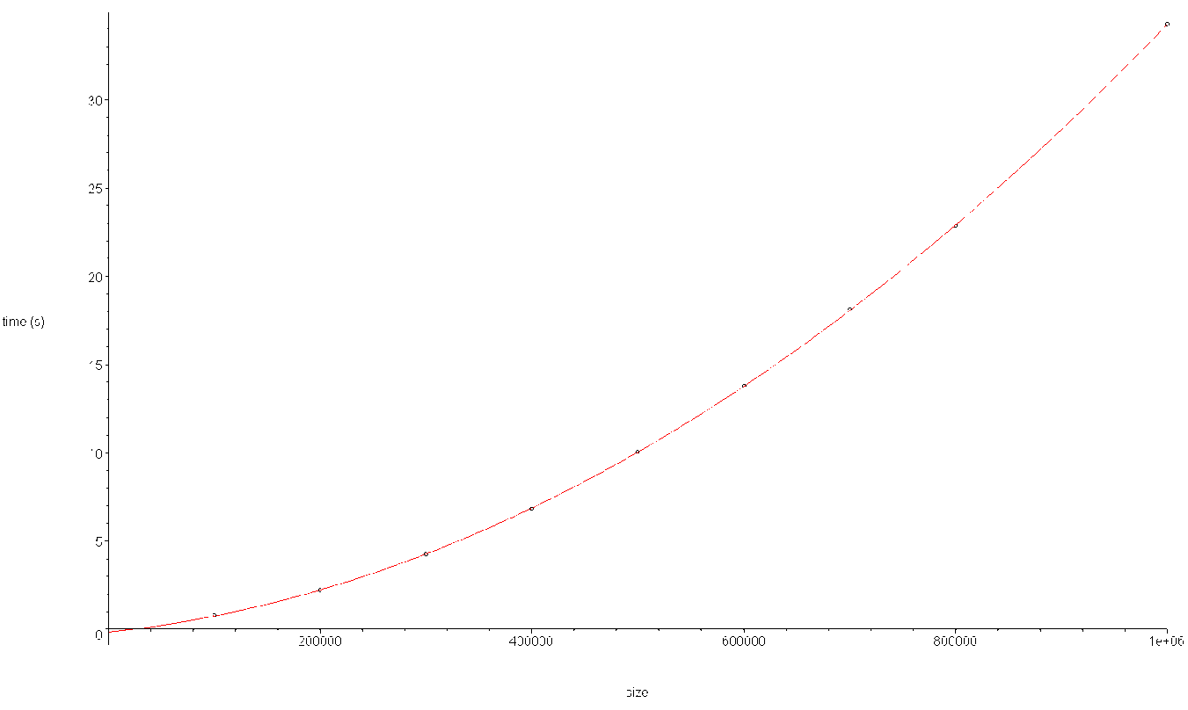
Memory Allocation
The least-squares best-fitting quadratic function is a good fit

Slide 36
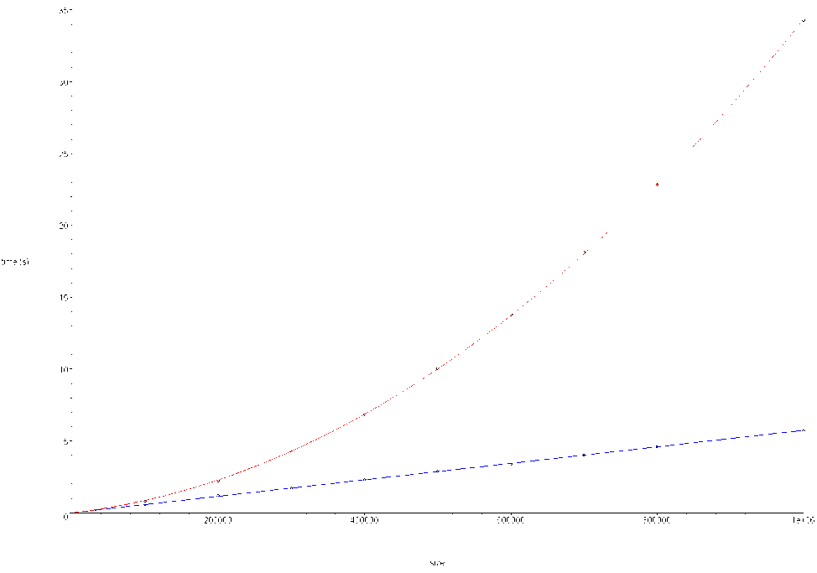
Memory Allocation
Thus, in the previous example, if we pre-allocate one million entries:
>> A = spalloc( 1000, 1000, 1000000 ); and then fill them, we get linear (blue) behaviour:

Slide 37
Memory Allocation
Because the copies are made only every 10 assignments, the effect is not that significant, the number of copies made is only 1/10th of those made if with each assignment:

Slide 38
Sample Test Runs
Matlab must maintain the compressed-column shape of the matrix, thus, inserting objects to the left of the right-most non-zero column must consequently require copying all entries over
recall: Matlab’s representation is column-first

Slide 39
Sample Test Runs
Thus, this code which assigns m entries:
>> n = 1024;
>> m = n*n;
>> A = spalloc( n, n, m );
>> for j = 1:n % for ( j = 1; j <= n; ++j )
for i = 1:n % for ( i = 1; i <= n; ++i )
A(i, j) = 1 + i + j;
end
end
runs in O(m) time
It took 5 s when I tried it

Slide 40
Sample Test Runs
While this code, which assigns m entries:
>> n = 1024;
>> m = n*n;
>> A = spalloc( n, n, m );
>> for i = n:-1:1 % for ( i = n; i >= 1; --i )
for j = n:-1:1 % for ( j = n; j >= 1; --j )
A(i, j) = 1 + i + j;
end
end
runs in O(m²) time
This took 7 min

Slide 41
Sample Test Runs
Even this code which assigns m entries:
>> n = 1024;
>> m = n*n;
>> A = spalloc( n, n, m );
>> for i = 1:n % for ( j = 1; j <= n; ++j )
for j = 1:n % for ( i = 1; i <= n; ++i )
A(i, j) = 1 + i + j;
end
end
also runs in O(m²) time
Only half the copies as with the previous case—just a little less time

Slide 42
Sample Test Runs
This is the worst-case order
>> n = 1024;
>> m = n*n;
>> A = spalloc( n, n, m );
>> for j = n:-1:1
for i = n:-1:1
A(i, j) = 1 + i + j;
end
end
I halted the computer after 30 min

Slide 43
Sample Test Runs
Consequently, it is your responsibility to use this data structure correctly:
It is designed to allow exceptionally fast accesses, including:
Fast matrix-matrix addition
Fast matrix-vector multiplication
Fast Gaussian elimination and backward substitution

Slide 44
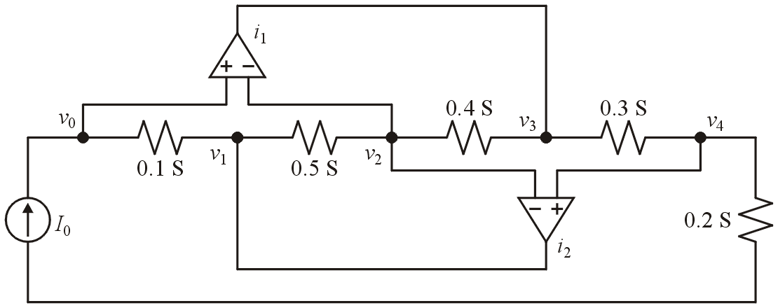
Example
Consider the following circuit with resistors and operational amplifies
This is from an example in Vlach and Singhal, p.143.

Slide 45
Example
The modified nodal representation of the circuit
is represented by this sparse matrix: recover the original matrix
I₀
0
1
2
3
4
5
6
7
IA | 0 | 2 | 6 | 9 | 13 | 15 | 17 | 19
0
1
2
3
4
5
6
7
8
9
10
11
12
13
14
15
16
17
18
JA | 0 | 1 | 0 | 1 | 2 | 6 | 1 | 2 | 3 | 2 | 3 | 4 | 5 | 3 | 4 | 0 | 2 | 2 | 4
A | 0.1 | -0.1 | -0.1 | 0.6 | -0.5 | 1.0 | -0.5 | 0.9 | -0.4 | -0.4 | 0.7 | -0.3 | 1.0 | -0.3 | 0.5 | 1.0 | -1.0 | -1.0 | 1.0

Slide 46
Example
It is a conductance matrix with op amps and is therefore square and not symmetric
The IA matrix has size 7 = N + 1 entries
The matrix is 7 × 7
The last entry of IA is 19
There are 19 non-zero entries
0
1
2
3
4
5
6
7
IA | 0 | 2 | 6 | 9 | 13 | 15 | 17 | 19
0
1
2
3
4
5
6
7
8
9
10
11
12
13
14
15
16
17
18
JA | 0 | 1 | 0 | 1 | 2 | 6 | 1 | 2 | 3 | 2 | 3 | 4 | 5 | 3 | 4 | 0 | 2 | 2 | 4
A | 0.1 | -0.1 | -0.1 | 0.6 | -0.5 | 1.0 | -0.5 | 0.9 | -0.4 | -0.4 | 0.7 | -0.3 | 1.0 | -0.3 | 0.5 | 1.0 | -1.0 | -1.0 | 1.0

Slide 47
Example
We will build the matrix row-by-row
0
1
2
3
4
5
6
7
IA | 0 | 2 | 6 | 9 | 13 | 15 | 17 | 19
0
1
2
3
4
5
6
7
8
9
10
11
12
13
14
15
16
17
18
JA | 0 | 1 | 0 | 1 | 2 | 6 | 1 | 2 | 3 | 2 | 3 | 4 | 5 | 3 | 4 | 0 | 2 | 2 | 4
A | 0.1 | -0.1 | -0.1 | 0.6 | -0.5 | 1.0 | -0.5 | 0.9 | -0.4 | -0.4 | 0.7 | -0.3 | 1.0 | -0.3 | 0.5 | 1.0 | -1.0 | -1.0 | 1.0

Slide 48
Example
Row 0 is stored in entries 0 and 1
IA[0] through IA[1] – 1
with entries
0.1 in column 0
-0.1 in column 1
0
1
2
3
4
5
6
7
IA | 0 | 2 | 6 | 9 | 13 | 15 | 17 | 19
0
1
2
3
4
5
6
7
8
9
10
11
12
13
14
15
16
17
18
JA | 0 | 1 | 0 | 1 | 2 | 6 | 1 | 2 | 3 | 2 | 3 | 4 | 5 | 3 | 4 | 0 | 2 | 2 | 4
A | 0.1 | -0.1 | -0.1 | 0.6 | -0.5 | 1.0 | -0.5 | 0.9 | -0.4 | -0.4 | 0.7 | -0.3 | 1.0 | -0.3 | 0.5 | 1.0 | -1.0 | -1.0 | 1.0

Slide 49
Example
Row 0 is stored in entries 0 and 1
IA[0] through IA[1] – 1
with entries
0.1 in column 0
–0.1 in column 1
0
1
2
3
4
5
6
7
IA | 0 | 2 | 6 | 9 | 13 | 15 | 17 | 19
0
1
2
3
4
5
6
7
8
9
10
11
12
13
14
15
16
17
18
JA | 0 | 1 | 0 | 1 | 2 | 6 | 1 | 2 | 3 | 2 | 3 | 4 | 5 | 3 | 4 | 0 | 2 | 2 | 4
A | 0.1 | -0.1 | -0.1 | 0.6 | -0.5 | 1.0 | -0.5 | 0.9 | -0.4 | -0.4 | 0.7 | -0.3 | 1.0 | -0.3 | 0.5 | 1.0 | -1.0 | -1.0 | 1.0

Slide 50
Example
Row 1 is stored in entries 2 through 5
IA[1] through IA[2] – 1
with entries
-0.1 in column 0
0.6 in column 1
-0.5 in column 2
1.0 in column 6
0
1
2
3
4
5
6
7
IA | 0 | 2 | 6 | 9 | 13 | 15 | 17 | 19
0
1
2
3
4
5
6
7
8
9
10
11
12
13
14
15
16
17
18
JA | 0 | 1 | 0 | 1 | 2 | 6 | 1 | 2 | 3 | 2 | 3 | 4 | 5 | 3 | 4 | 0 | 2 | 2 | 4
A | 0.1 | -0.1 | -0.1 | 0.6 | -0.5 | 1.0 | -0.5 | 0.9 | -0.4 | -0.4 | 0.7 | -0.3 | 1.0 | -0.3 | 0.5 | 1.0 | -1.0 | -1.0 | 1.0

Slide 51
Example
Row 1 is stored in entries 2 through 5
IA[1] through IA[2] – 1
with entries
-0.1 in column 0
0.6 in column 1
-0.5 in column 2
1.0 in column 6
0
1
2
3
4
5
6
7
IA | 0 | 2 | 6 | 9 | 13 | 15 | 17 | 19
0
1
2
3
4
5
6
7
8
9
10
11
12
13
14
15
16
17
18
JA | 0 | 1 | 0 | 1 | 2 | 6 | 1 | 2 | 3 | 2 | 3 | 4 | 5 | 3 | 4 | 0 | 2 | 2 | 4
A | 0.1 | -0.1 | -0.1 | 0.6 | -0.5 | 1.0 | -0.5 | 0.9 | -0.4 | -0.4 | 0.7 | -0.3 | 1.0 | -0.3 | 0.5 | 1.0 | -1.0 | -1.0 | 1.0

Slide 52
Example
Row 2 is stored in entries 6, 7, and 8
IA[2] through IA[3] – 1
with entries
-0.5 in column 1
0.9 in column 2
-0.4 in column 3
0
1
2
3
4
5
6
7
IA | 0 | 2 | 6 | 9 | 13 | 15 | 17 | 19
0
1
2
3
4
5
6
7
8
9
10
11
12
13
14
15
16
17
18
JA | 0 | 1 | 0 | 1 | 2 | 6 | 1 | 2 | 3 | 2 | 3 | 4 | 5 | 3 | 4 | 0 | 2 | 2 | 4
A | 0.1 | -0.1 | -0.1 | 0.6 | -0.5 | 1.0 | -0.5 | 0.9 | -0.4 | -0.4 | 0.7 | -0.3 | 1.0 | -0.3 | 0.5 | 1.0 | -1.0 | -1.0 | 1.0

Slide 53
Example
Row 2 is stored in entries 6, 7, and 8
IA[2] through IA[3] – 1
with entries
-0.5 in column 1
0.9 in column 2
-0.4 in column 3
0
1
2
3
4
5
6
7
IA | 0 | 2 | 6 | 9 | 13 | 15 | 17 | 19
0
1
2
3
4
5
6
7
8
9
10
11
12
13
14
15
16
17
18
JA | 0 | 1 | 0 | 1 | 2 | 6 | 1 | 2 | 3 | 2 | 3 | 4 | 5 | 3 | 4 | 0 | 2 | 2 | 4
A | 0.1 | -0.1 | -0.1 | 0.6 | -0.5 | 1.0 | -0.5 | 0.9 | -0.4 | -0.4 | 0.7 | -0.3 | 1.0 | -0.3 | 0.5 | 1.0 | -1.0 | -1.0 | 1.0

Slide 54
Example
Row 3 is stored in entries 9 through 12
IA[3] through IA[4] – 1
with entries
-0.4 in column 2
0.7 in column 3
-0.3 in column 4
1.0 in column 5
0
1
2
3
4
5
6
7
IA | 0 | 2 | 6 | 9 | 13 | 15 | 17 | 19
0
1
2
3
4
5
6
7
8
9
10
11
12
13
14
15
16
17
18
JA | 0 | 1 | 0 | 1 | 2 | 6 | 1 | 2 | 3 | 2 | 3 | 4 | 5 | 3 | 4 | 0 | 2 | 2 | 4
A | 0.1 | -0.1 | -0.1 | 0.6 | -0.5 | 1.0 | -0.5 | 0.9 | -0.4 | -0.4 | 0.7 | -0.3 | 1.0 | -0.3 | 0.5 | 1.0 | -1.0 | -1.0 | 1.0

Slide 55
Example
Row 3 is stored in entries 9 through 12
IA[3] through IA[4] – 1
with entries
-0.4 in column 2
0.7 in column 3
-0.3 in column 4
1.0 in column 5
0
1
2
3
4
5
6
7
IA | 0 | 2 | 6 | 9 | 13 | 15 | 17 | 19
0
1
2
3
4
5
6
7
8
9
10
11
12
13
14
15
16
17
18
JA | 0 | 1 | 0 | 1 | 2 | 6 | 1 | 2 | 3 | 2 | 3 | 4 | 5 | 3 | 4 | 0 | 2 | 2 | 4
A | 0.1 | -0.1 | -0.1 | 0.6 | -0.5 | 1.0 | -0.5 | 0.9 | -0.4 | -0.4 | 0.7 | -0.3 | 1.0 | -0.3 | 0.5 | 1.0 | -1.0 | -1.0 | 1.0

Slide 56
Example
Row 4 is stored in entries 13 and 14
IA[4] through IA[5] – 1
with entries
-0.3 in column 2
0.5 in column 3
0
1
2
3
4
5
6
7
IA | 0 | 2 | 6 | 9 | 13 | 15 | 17 | 19
0
1
2
3
4
5
6
7
8
9
10
11
12
13
14
15
16
17
18
JA | 0 | 1 | 0 | 1 | 2 | 6 | 1 | 2 | 3 | 2 | 3 | 4 | 5 | 3 | 4 | 0 | 2 | 2 | 4
A | 0.1 | -0.1 | -0.1 | 0.6 | -0.5 | 1.0 | -0.5 | 0.9 | -0.4 | -0.4 | 0.7 | -0.3 | 1.0 | -0.3 | 0.5 | 1.0 | -1.0 | -1.0 | 1.0

Slide 57
Example
Row 4 is stored in entries 13 and 14
IA[4] through IA[5] – 1
with entries
-0.3 in column 2
0.5 in column 3
0
1
2
3
4
5
6
7
IA | 0 | 2 | 6 | 9 | 13 | 15 | 17 | 19
0
1
2
3
4
5
6
7
8
9
10
11
12
13
14
15
16
17
18
JA | 0 | 1 | 0 | 1 | 2 | 6 | 1 | 2 | 3 | 2 | 3 | 4 | 5 | 3 | 4 | 0 | 2 | 2 | 4
A | 0.1 | -0.1 | -0.1 | 0.6 | -0.5 | 1.0 | -0.5 | 0.9 | -0.4 | -0.4 | 0.7 | -0.3 | 1.0 | -0.3 | 0.5 | 1.0 | -1.0 | -1.0 | 1.0

Slide 58
Example
Row 5 is stored in entries 15 and 16
IA[5] through IA[6] – 1
with entries
1.0 in column 0
-1.0 in column 2
0
1
2
3
4
5
6
7
IA | 0 | 2 | 6 | 9 | 13 | 15 | 17 | 19
0
1
2
3
4
5
6
7
8
9
10
11
12
13
14
15
16
17
18
JA | 0 | 1 | 0 | 1 | 2 | 6 | 1 | 2 | 3 | 2 | 3 | 4 | 5 | 3 | 4 | 0 | 2 | 2 | 4
A | 0.1 | -0.1 | -0.1 | 0.6 | -0.5 | 1.0 | -0.5 | 0.9 | -0.4 | -0.4 | 0.7 | -0.3 | 1.0 | -0.3 | 0.5 | 1.0 | -1.0 | -1.0 | 1.0

Slide 59
Example
Row 5 is stored in entries 15 and 16
IA[5] through IA[6] – 1
with entries
1.0 in column 0
-1.0 in column 2
0
1
2
3
4
5
6
7
IA | 0 | 2 | 6 | 9 | 13 | 15 | 17 | 19
0
1
2
3
4
5
6
7
8
9
10
11
12
13
14
15
16
17
18
JA | 0 | 1 | 0 | 1 | 2 | 6 | 1 | 2 | 3 | 2 | 3 | 4 | 5 | 3 | 4 | 0 | 2 | 2 | 4
A | 0.1 | -0.1 | -0.1 | 0.6 | -0.5 | 1.0 | -0.5 | 0.9 | -0.4 | -0.4 | 0.7 | -0.3 | 1.0 | -0.3 | 0.5 | 1.0 | -1.0 | -1.0 | 1.0

Slide 60
Example
Row 6 is stored in entries 17 and 18
IA[6] through IA[7] – 1
with entries
-1.0 in column 2
1.0 in column 4
0
1
2
3
4
5
6
7
IA | 0 | 2 | 6 | 9 | 13 | 15 | 17 | 19
0
1
2
3
4
5
6
7
8
9
10
11
12
13
14
15
16
17
18
JA | 0 | 1 | 0 | 1 | 2 | 6 | 1 | 2 | 3 | 2 | 3 | 4 | 5 | 3 | 4 | 0 | 2 | 2 | 4
A | 0.1 | -0.1 | -0.1 | 0.6 | -0.5 | 1.0 | -0.5 | 0.9 | -0.4 | -0.4 | 0.7 | -0.3 | 1.0 | -0.3 | 0.5 | 1.0 | -1.0 | -1.0 | 1.0

Slide 61
Example
Row 6 is stored in entries 17 and 18
IA[6] through IA[7] – 1
with entries
-1.0 in column 2
1.0 in column 4
0
1
2
3
4
5
6
7
IA | 0 | 2 | 6 | 9 | 13 | 15 | 17 | 19
0
1
2
3
4
5
6
7
8
9
10
11
12
13
14
15
16
17
18
JA | 0 | 1 | 0 | 1 | 2 | 6 | 1 | 2 | 3 | 2 | 3 | 4 | 5 | 3 | 4 | 0 | 2 | 2 | 4
A | 0.1 | -0.1 | -0.1 | 0.6 | -0.5 | 1.0 | -0.5 | 0.9 | -0.4 | -0.4 | 0.7 | -0.3 | 1.0 | -0.3 | 0.5 | 1.0 | -1.0 | -1.0 | 1.0

Slide 62
Example
Consequently, we have recovered the modified nodal representation:
0
1
2
3
4
5
6
7
IA | 0 | 2 | 6 | 9 | 13 | 15 | 17 | 19
0
1
2
3
4
5
6
7
8
9
10
11
12
13
14
15
16
17
18
JA | 0 | 1 | 0 | 1 | 2 | 6 | 1 | 2 | 3 | 2 | 3 | 4 | 5 | 3 | 4 | 0 | 2 | 2 | 4
A | 0.1 | -0.1 | -0.1 | 0.6 | -0.5 | 1.0 | -0.5 | 0.9 | -0.4 | -0.4 | 0.7 | -0.3 | 1.0 | -0.3 | 0.5 | 1.0 | -1.0 | -1.0 | 1.0

Slide 63
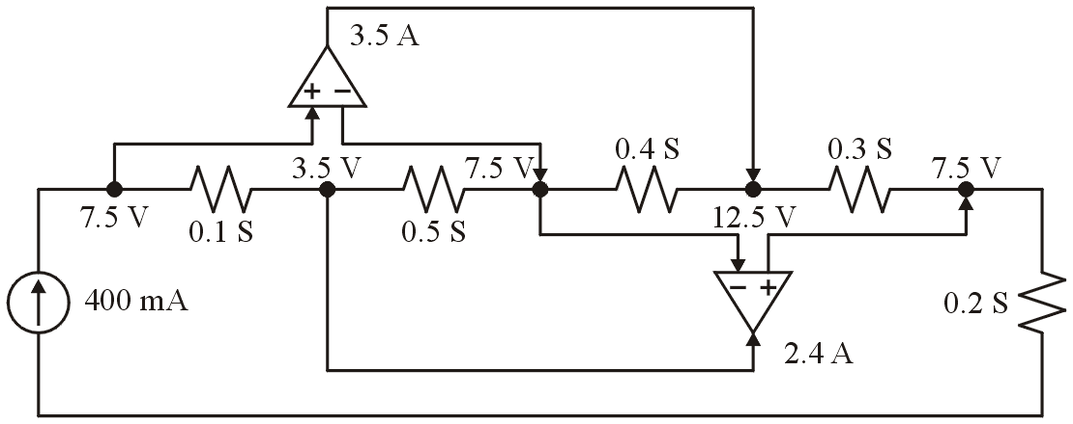
Example
If I₀ = 400 mA, then the system
yields the solution

Slide 64
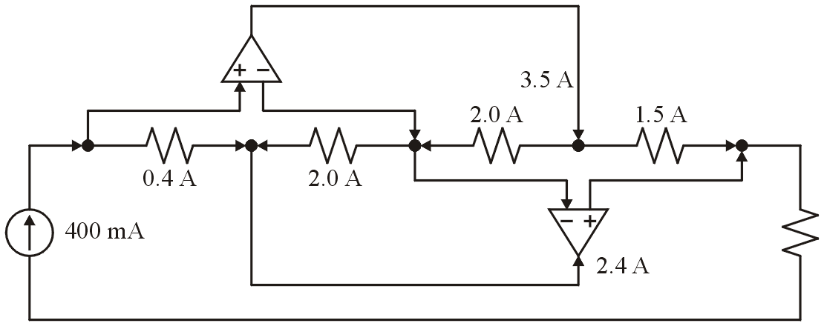
Example
At this point, we can simply use Ohms law to determine the remaining currents

Slide 65
Summary
In this topic, we have looked at the old Yale sparse matrix representation
Both memory usage and many operations for N × N matrices with m non-zero entries are reduced from Θ(N²) to Θ(m)
Accessing entries is reduced to O(m/N)
Incorrect usage, however, leads to serious run-time slow downs...

Slide 66
References

Slide 67
References
Wikipedia, http://en.wikipedia.org/wiki/Sparse_matrix#Yale_format
[1] Donald E. Knuth, The Art of Computer Programming, Volume 1: Fundamental Algorithms, 3rd Ed., Addison Wesley, 1997, §2.2.1, p.238.
[2] Cormen, Leiserson, and Rivest, Introduction to Algorithms, McGraw Hill, 1990, §11.1, p.200.
[3] Weiss, Data Structures and Algorithm Analysis in C++, 3rd Ed., Addison Wesley, §3.6, p.94.
[4] Randolph E. Bank, Craig C. Douglas Sparse Matrix Multiplication Package (SMMP), April 23, 2001.
[5] Jiri Vlach and Kishore Singhal, Computer Methods for Circuit Analysis and Design, 2nd Ed., Chapman and Hall, 1994.
[6] Iain Duff, Roger Grimes, John Lewis, User's Guide for the Harwell-Boeing Sparse Matrix Collection, Technical Report TR/PA/92/86, CERFACS, October 1992.
These slides are provided for the ECE 250 Algorithms and Data Structures course. The material in it reflects Douglas W. Harder’s best judgment in light of the information available to him at the time of preparation. Any reliance on these course slides by any party for any other purpose are the responsibility of such parties. Douglas W. Harder accepts no responsibility for damages, if any, suffered by any party as a result of decisions made or actions based on these course slides for any other purpose than that for which it was intended.

